Slide 1

Broncode:
An Interactive Programming Tutorial Platform
Alexander Wardell, Charles Noble, Ahmed Radwan, Josh Chandler

Slide 2
Outline
Background
Problem and Solution
Client
Design and Design Choices
Implementation
Maintenance and Security
Testing
Summary

Slide 3
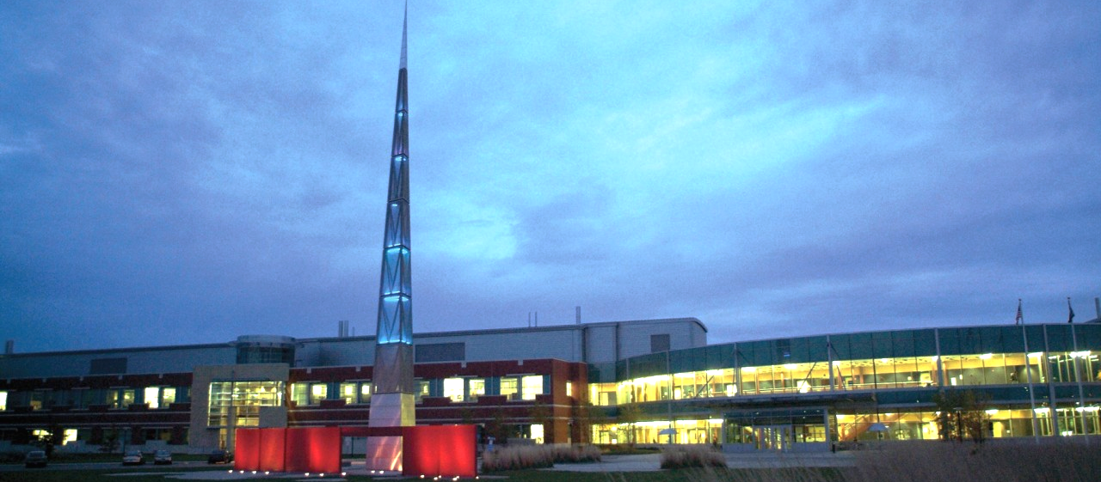
Background
We are Senior Computer Science students at WMU
We have Elearning for quizzes and long-form assignments
CS Professors use disparate sites for interactive content:
Canvas
Textbook-specific software
No WMU-owned or FOSS solution

Slide 4




Problem
We need a simple, intuitive way to create self-contained coding tutorials that involve writing real code

Slide 5

Solution
Host the lessons, code editing, compiling, running, and grading all on a website that can be accessed in a single view via a web browser.
We call this website Broncode

Slide 6
Solution (cont’d)
The core of Broncode is an interactive tutorial where you...

Slide 7
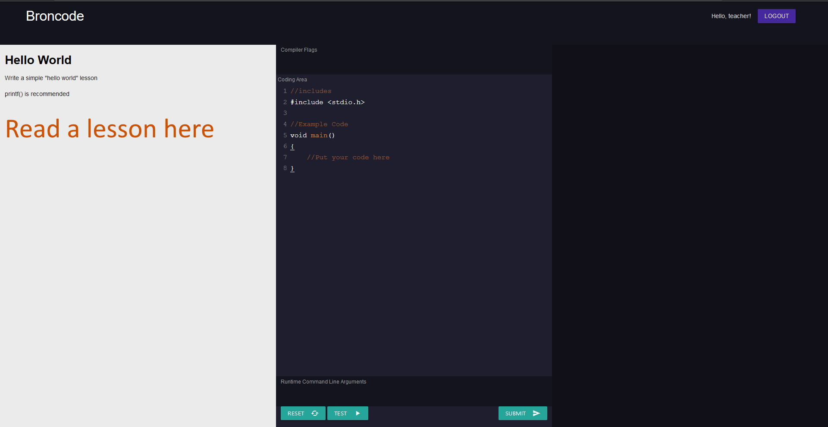
Solution (cont’d)

Slide 8
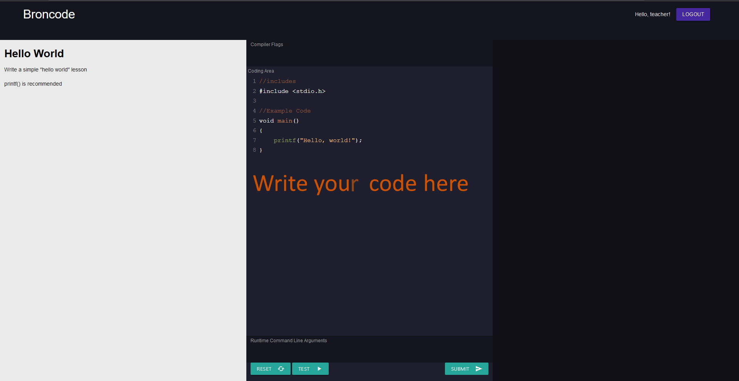

Slide 9
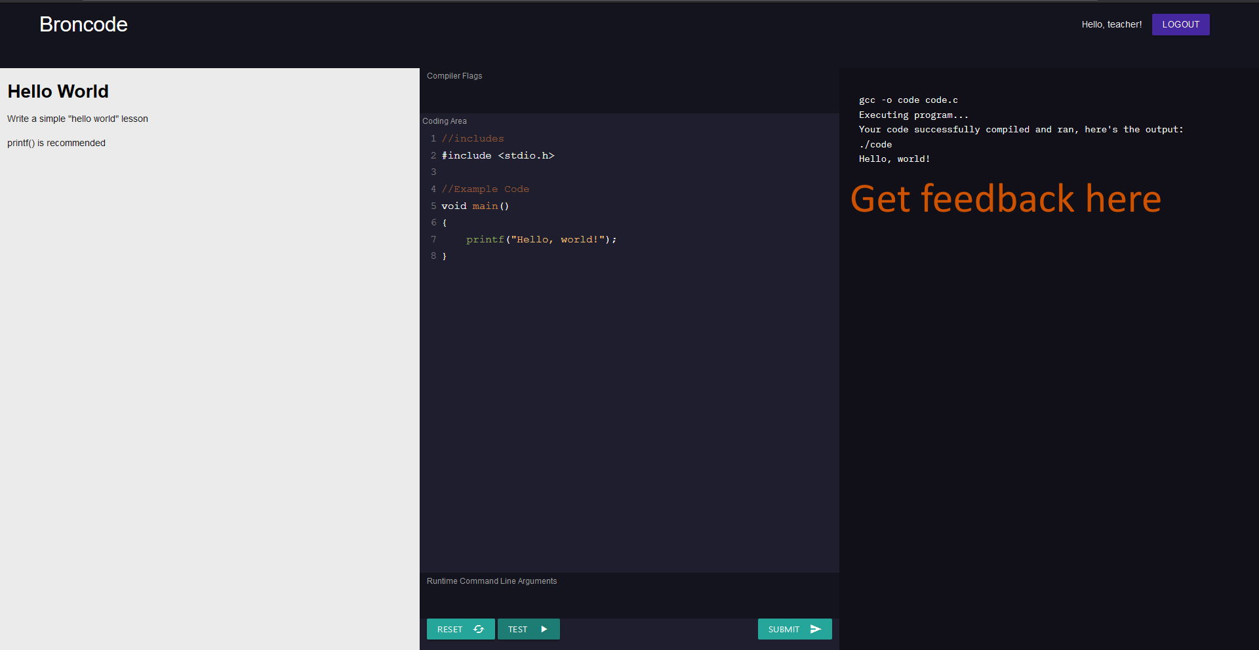

Slide 10
Solution (cont’d)
Tutorial System:
Workflow conducive to the development of programming skills
Resembles common debugging processes
Read/Reread Task
Receive Feedback
Adjust Code

Slide 11


Client
The computer science department here at Western Michigan University, and as such the target audience of this presentation is those in computer science, software engineering, and higher education.

Slide 12
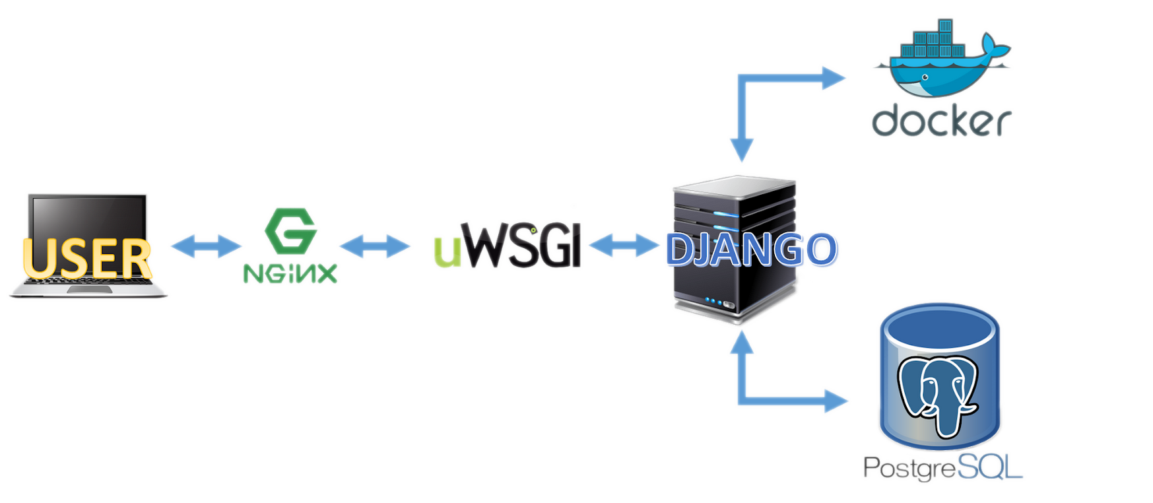
Design Choices
Nginx + uWSGI
Django
Docker
PostgreSQL
CodeMirror

Slide 13


Nginx + uWSGI
Description
Nginx
Web Server
Reverse Proxy
Load Balancer
uWSGI
Python Web Server Gateway Interface

Slide 14

Django
Description
Python-based web application framework
Follows the MTV model: Model-Template-View

Slide 15
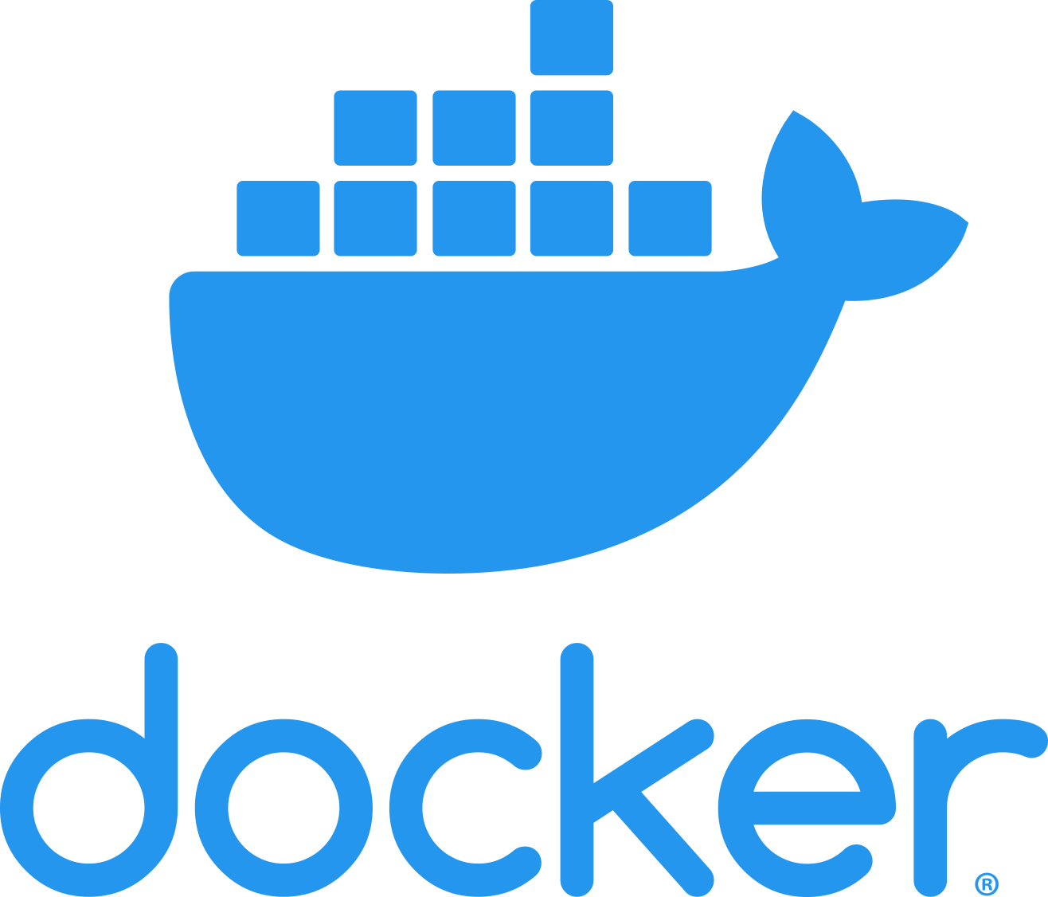
Docker
Description
A platform for developing Isolated applications
Effortless scalability
Easily configurable

Slide 16

Postgres (PostgreSQL)
Description
Free and Open Source Relational Database Management System (RDBMS)
Python API for database access
Notes:
Postgres vs. MariaDB

Slide 17

CodeMirror
Description
Browser text editor implemented in HTML/JS
Supports 100+ languages
Modern IDE/Editor features

Slide 18
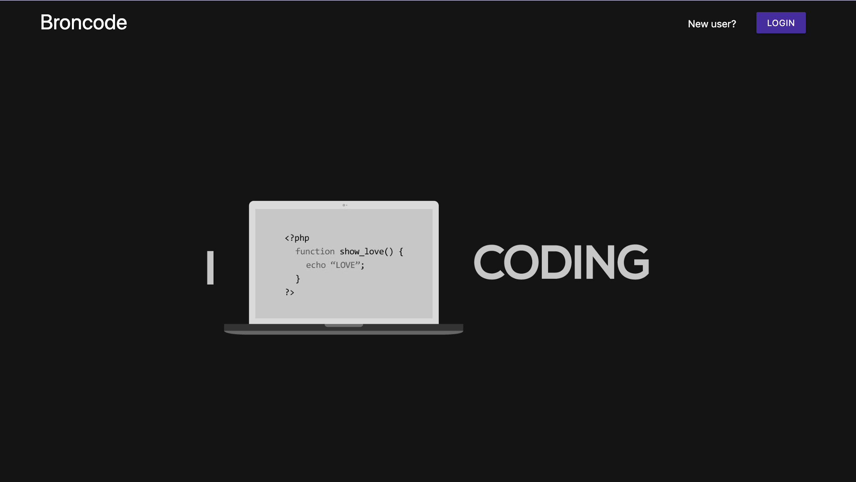

Slide 19

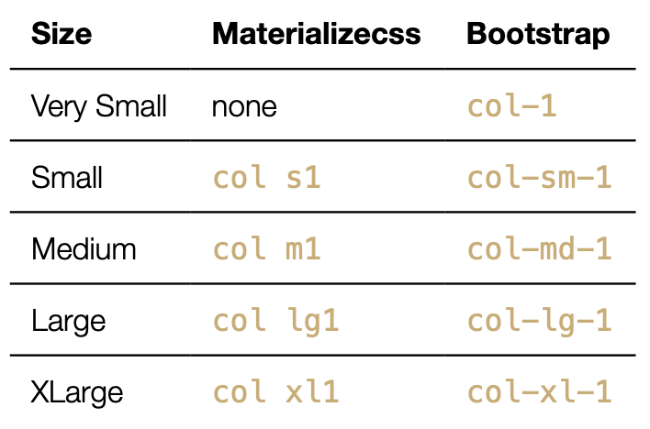
Materialize
Description
More Simple and Modern
Conforms to Material Design
UI feels and looks as if it were made out of physical material
Uses 12 Column Grid Layout
Want to use Bootstrap?
Easily swap between MaterializeCSS and Bootstrap syntax.
Notes:
Material Design: Tries to replicate how a user interface would work if it were made out of physical material

Slide 20
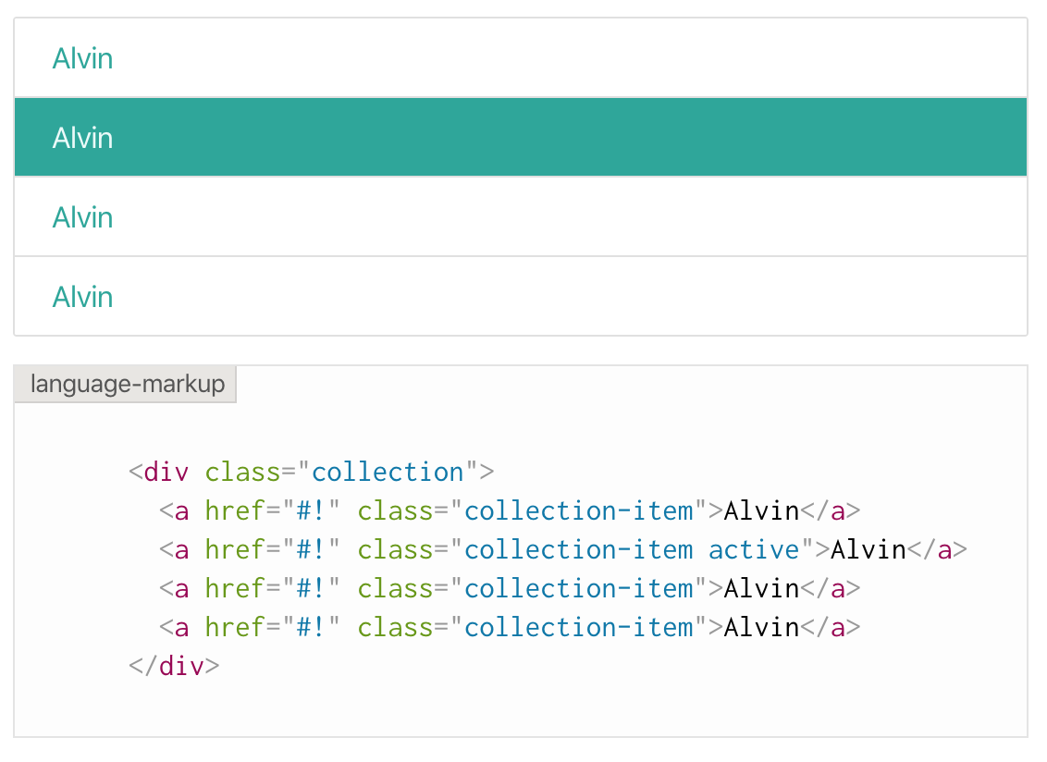
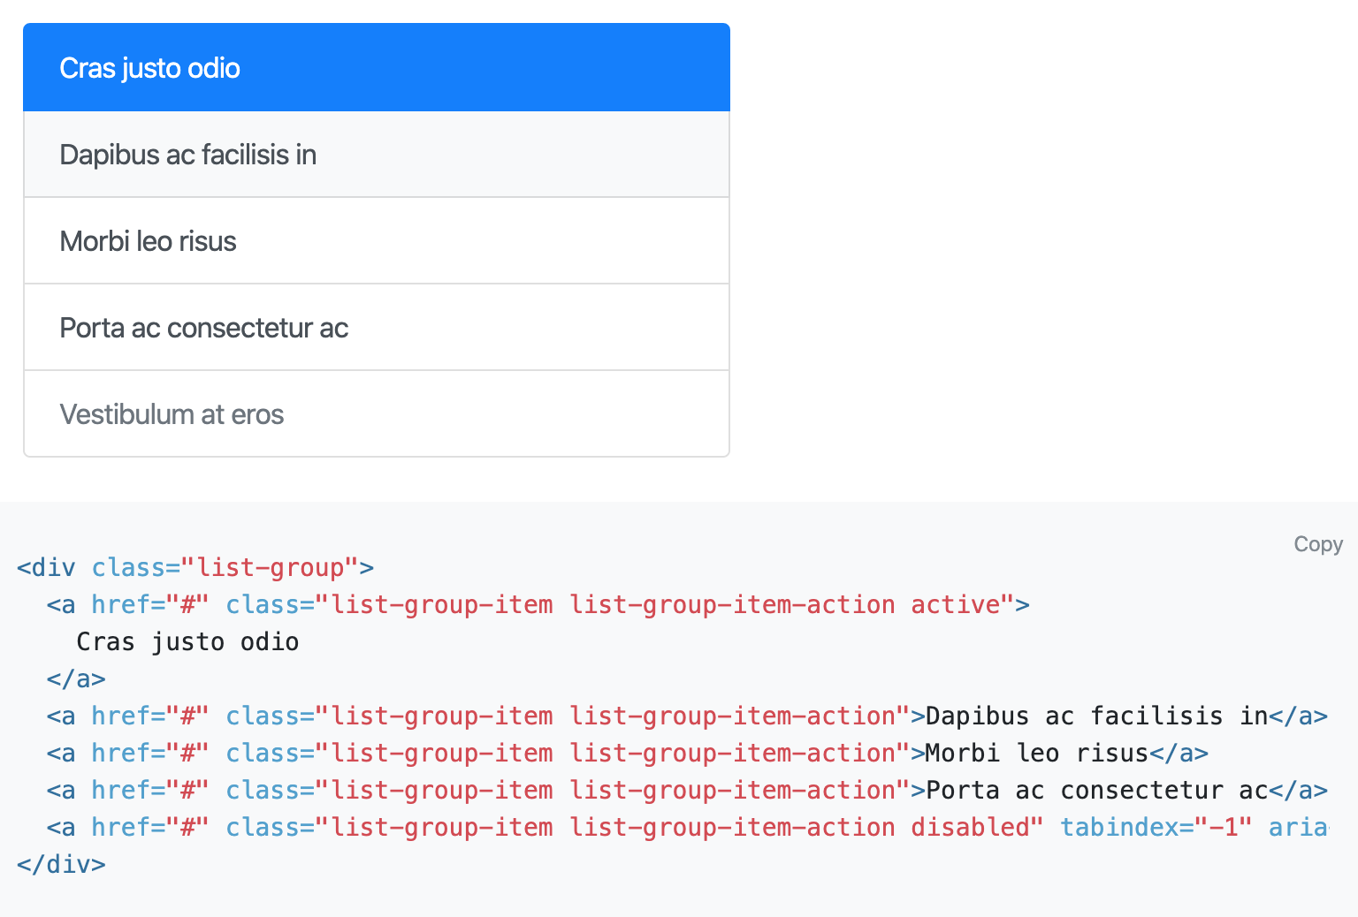
MaterializeCSS vs Bootstrap

Slide 21
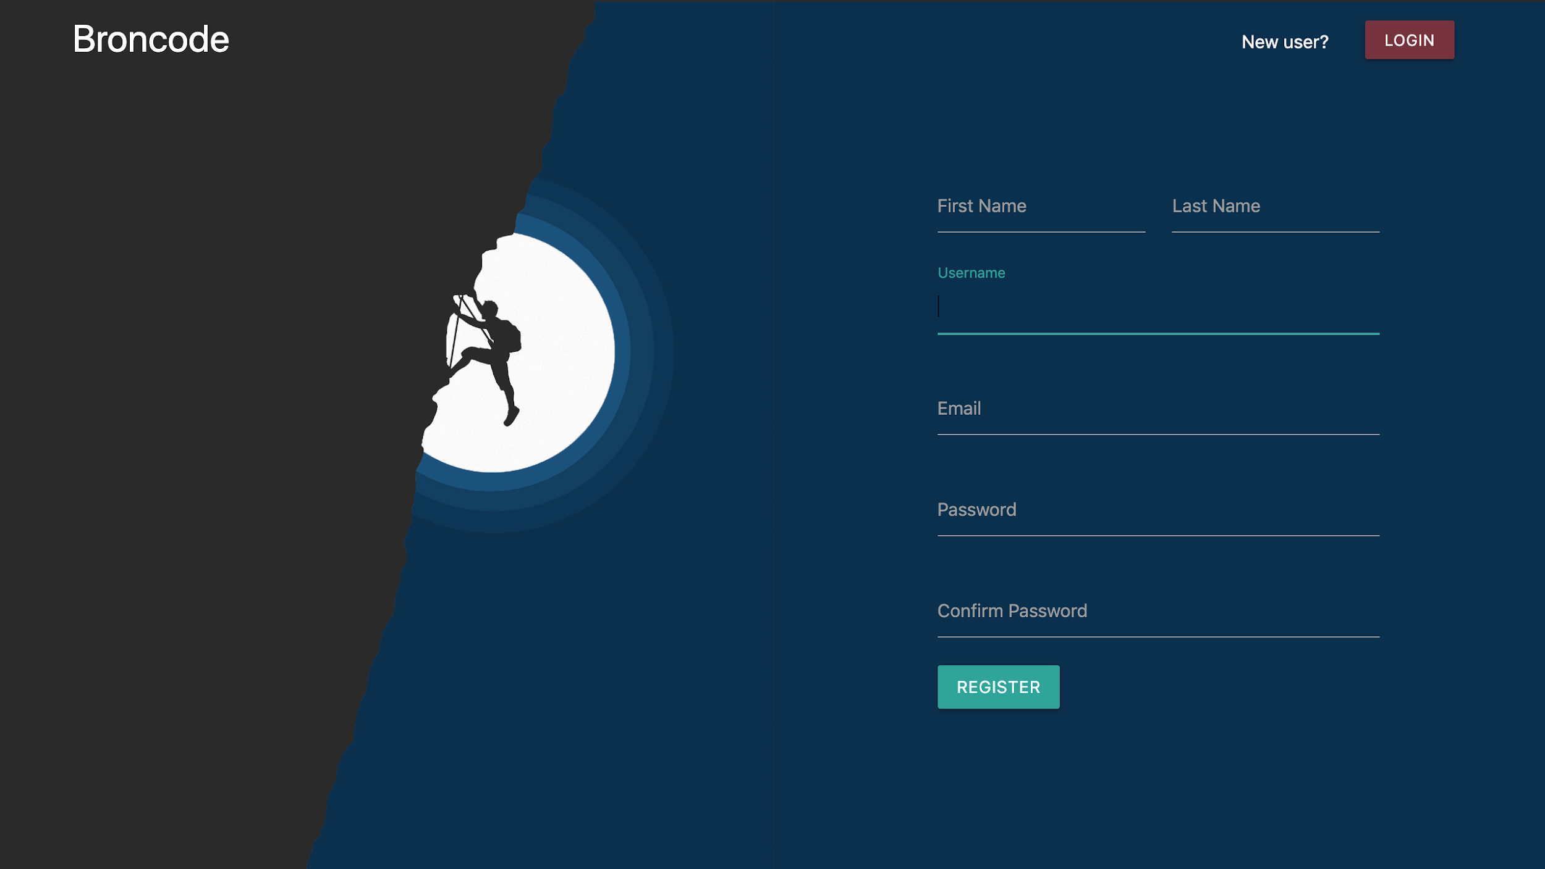

Slide 22

User Registration Demo
Notes:
All handled by django

Slide 23
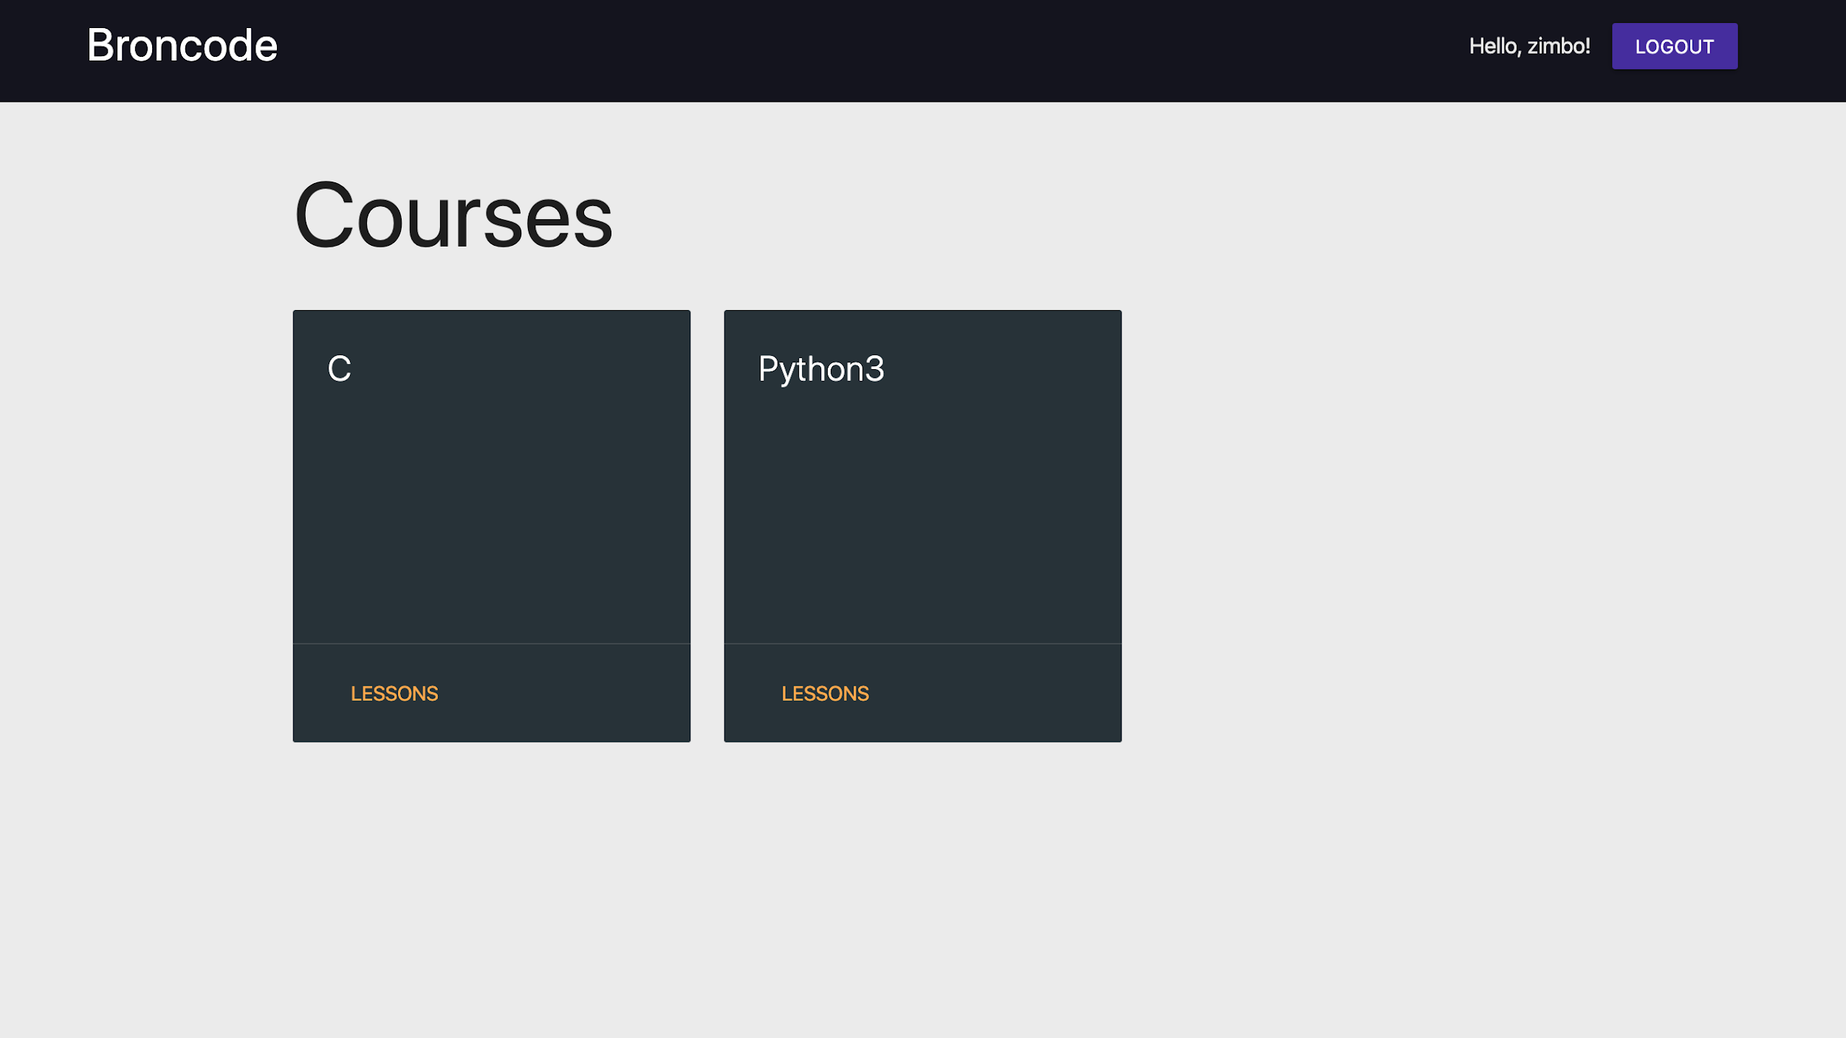
INSERT WEBSITE INSTRUCTOR HOMEPAGE HERE
Course/lessons page
Notes:
Teacher can create or delete courses

Slide 24
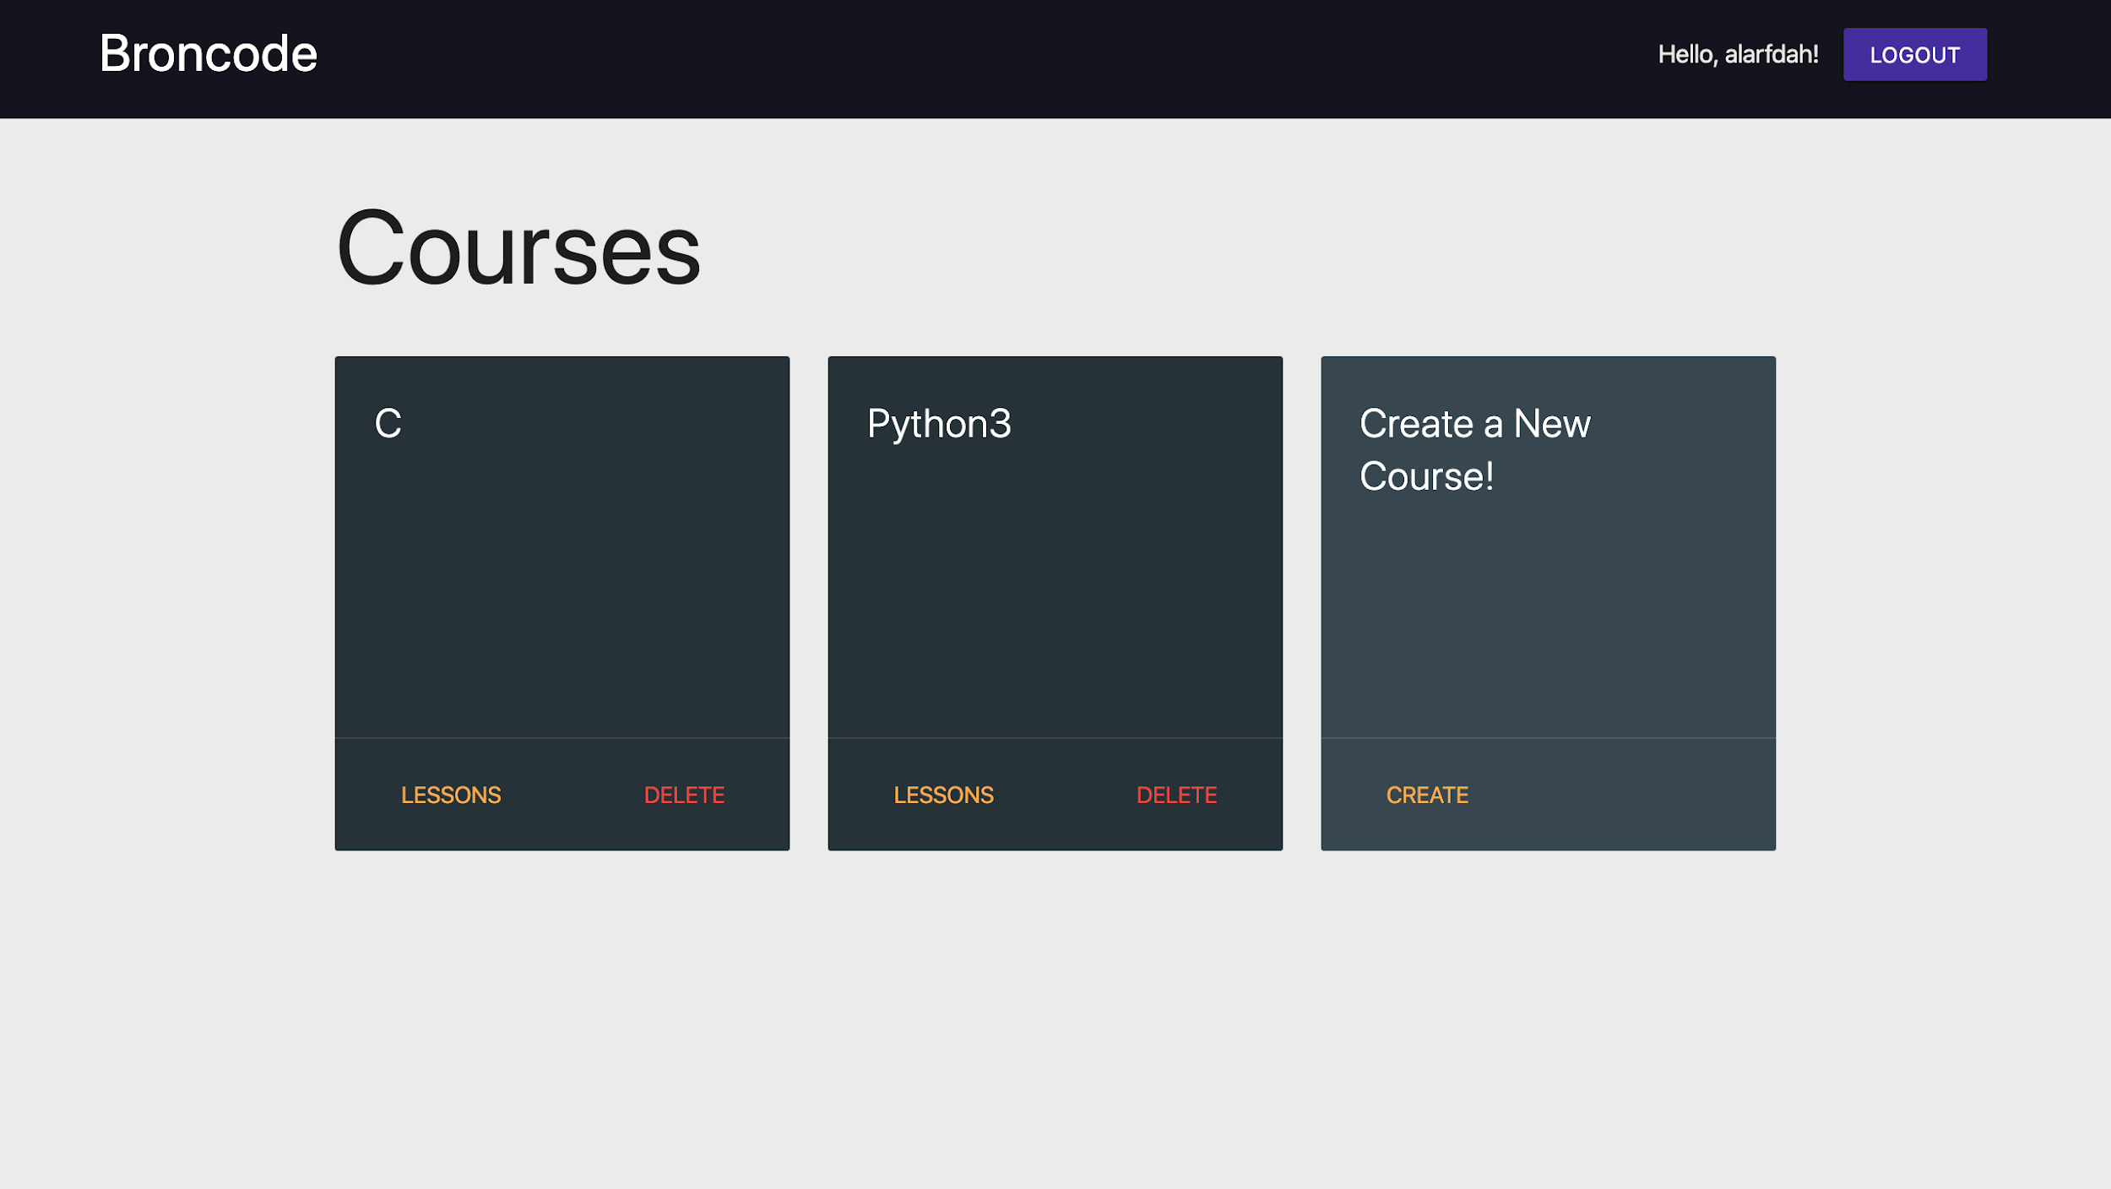
INSERT WEBSITE INSTRUCTOR HOMEPAGE HERE
Course/lessons page
Notes:
Teacher can create or delete courses

Slide 25
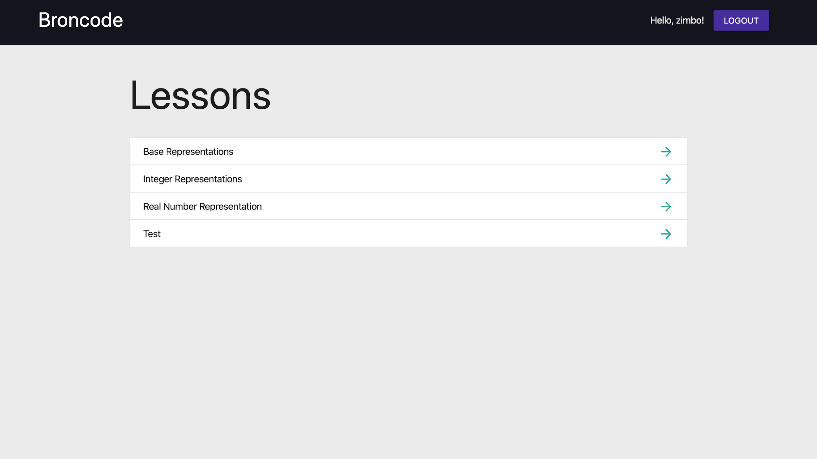

Slide 26
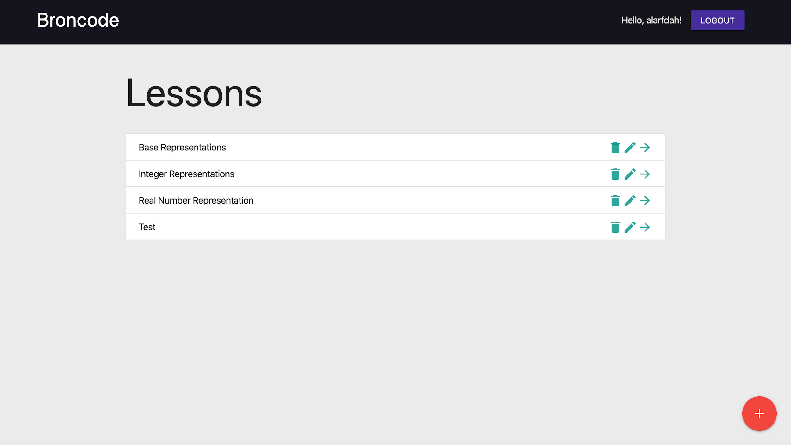

Slide 27
Course Selection and Creation Demo

Slide 28

Markdown
Description
Lightweight markup language with plain text formatting syntax.
Can be converted to many output formats.
Allows for `headers`, `bulleted lists`, and `code blocks`
Notes:
Material Design: Tries to replicate how a user interface would work if it were made out of physical material

Slide 29
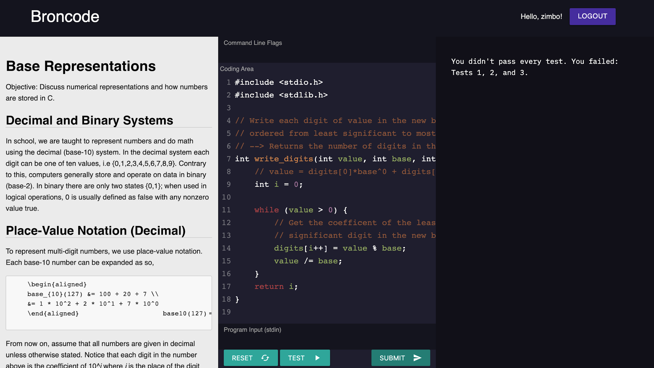
Markdown
Compiler Flags
Student’s Code
Standard Input
Code Output
Notes:
Students will complete assignments and practice tutorials using the website’s online code editor and compiler. The tutorials themselves use Markdown to provide a clear and concise way to present information.

Slide 30
Code Tutorial Demo

Slide 31

Maintenance & Future Development
Django admin panel for easy database maintenance
Docker containers are maintained via code
New languages just require a new container

Slide 32
C Executor
Code Client
Communicates with Code Server
Code Server
Selects Executor and sends/receives code
Python3 Executor
R Executor

Slide 33
Pieces of a new Language Backend
Configure Port
Configure Codeserver
Configure Executor
Language | Port
C | 4000
Python3 | 4001
R | 4002
Go | 4003
def main():
h = '' # host
p = 4003 # port
exec = GoExecutor # executor
server = CodeServer(h,p,exec)
server.handle_connection()
def compile(self):
cmd_compile = ["go", "build"] + self.flags
…
def run(self):
cmd_run_base = ["./code"]
…

Slide 34

Testing
Django has built-in unit test capabilities
Unit tests for individual docker containers
Automatic stress testing for the docker containers
Accessibility testing via WAVE and University specialist, Taylor Arndt

Slide 35
Accessibility Findings
Login and register forms generated by Django are not fully accessible
Codemirror lacks accessibility features and will need upgrading after the next version is stable
Site navigation will have to be more robust in the future

Slide 36

Security
Code is run in isolated docker containers
Protection from XSS, SQL injection
CSRF tokens required on forms as is required by Django
IPtables ensures no outside access to ports

Slide 37

Summary
Online Solution For Learning Languages and Concepts
Scalable, modular, easily maintainable design
Secure, highly controlled code execution

Slide 38
Q/A

